Slide 1
Hack-IoT 2019 Image Computation and Recognition
3/24/2019
Group 10: Spencer McDonough, Ayush Garg, Valerie Gomez

Slide 2
Big Data for Sustainable Development
The United Nations classifies Traffic Control as a Global Issue.
Data from GPS devices can be used for traffic control,
For making public transport better,
For avoiding collisions,
For Insurance claims,
For use as evidence for crashes/accidents.

Slide 3
I3 Marketplace
There are many barriers preventing the adoption of the Internet of Things (IoT) in smart communities and smart cities, including interoperability, concerns about vendor lock-in, economic constraints, and privacy issues.
Applications and data brokers access and provide value-added services to these IOT-based communities.
Allows client to send image for processing to a much more powerful computer and receives the processed image through the Marketplace.

Slide 4
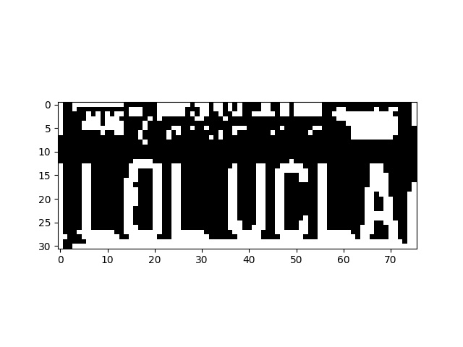
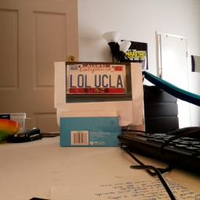
Raw and Processed Image

